Slide 1


Slide 2
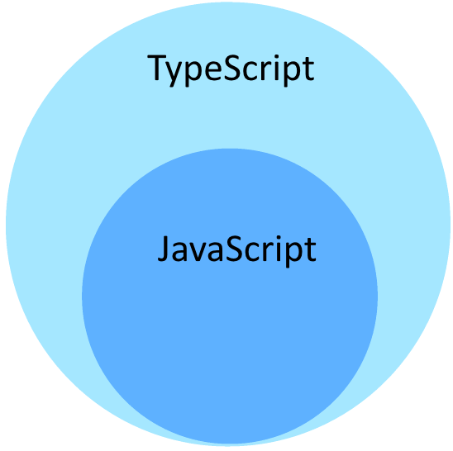
What is ts?
TypeScript is a typed superset of JavaScript
that compiles to plain JavaScript.

Slide 3
What is ts?
TypeScript allow us to use regular js with types.
Any of your js files is probably a valid typescript file.
Introduce new extension: ‘.ts’

Slide 4
Types
number
string
boolean
void
null
undefined
any

Slide 5
More Types
Array<number>
Promise<string>
string | null
your_class_name
...

Slide 6
Types - examples
var a:string = ”3”;
function warnUser(): void
function fn(x: () => void)
var arr: Array<numbers> = [1, 2, 3];
var x: [string, number] = [“hello”, 0];

Slide 7
Enums
enum Color {
Red= 8,
Green,
Blue
}
let c: Color = Color.Green;

Slide 8
OOP
class Car { engine: string; constructor (engine: string) { this.engine = engine; } }
class Track extends Car {
….
}

Slide 9
Interfaces
interface A {
nothing: string;
blabla: number;
}
class B implements A {
nothing = ‘5’;
blabla = 5;
}

Slide 10
Interfaces
interface A {
nothing: string;
blabla: number;
}
var a: A = { nothing: “something”;
blabla: 555; }

Slide 11
Generics
class GenericNumber<T> {
zeroValue: T;
add: (x: T, y: T) => T;
}

Slide 12
TS - How?
Now how’s js files supposed to compile to plain JavaScript?
We have the TypeScript compiler.
npm install -g typescript
To compile ts file:
tsc fileName.ts

Slide 13
TS - Compiling a project
We have a tsconfig.json file.
You will encounter this one a lot and you need
to understand how to configure it

Slide 14
TS - Compiling a project
{
"compilerOptions": {
"module": "commonjs",
"noImplicitAny": true,
"removeComments": true,
"preserveConstEnums": true,
"sourceMap": true
},
"files": [
"./src/*.ts",
"./src/**/*.ts”
],
“exclude”: [“./node_modules”]
}

Slide 15
TS - Compiling a project
To generate basic config file:
tsc --init
To compile your project with your configuration:
tsc --project tsconfig.json

Slide 16
TS - JavaScript libraries in TypeScript projects
The best practice in Web libraries is compiling everything to plain JavaScript.
How’s my IDE supposed to recognize different types of libraries?
For example when using bootstrap js typescript can’t know all of the object types (js has no types).

Slide 17
TS - Declaration File
For that we have d.ts files.
Those file declare the typings of our written code:
declare module ExampleModule {
module AnotherModule {
class Foo implements Bar {
constructor();
public getFoo(name: string, optionalParameter?: number): Foo;
}
interface Bar {
getFoo(name: string, optionalParameter?: number): Foo;
}
}
}

Slide 18
TS - why?
Strong tool for large apps - maintainability
Less typings mistakes
No more wrong parameters sent to a function!
OOP

Slide 19

TS ♥

